Slide 1
Deconvolution
Tom Jhou

Slide 2
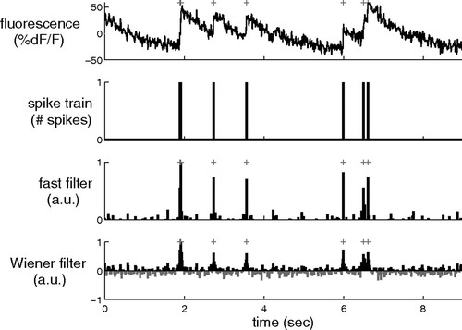
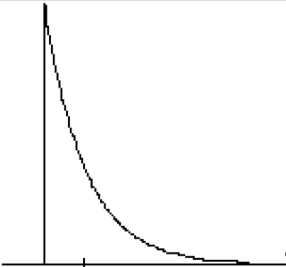


Application: recovering spike trains using deconvolution
Calcium signals reflect spike trains (not directly observable) convolved with exponential decay. Need deconvolution to recover spike train.
$$⨂$$
(what you want to measure)
$$+ noise=$$
(what you can actually see)
Notes:
Not optimal

Slide 3
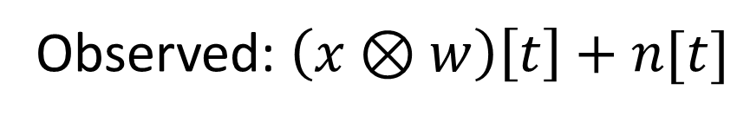
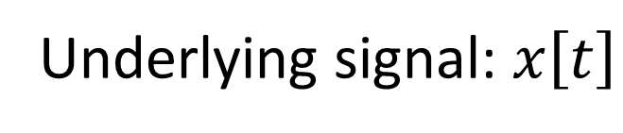
Model:
Underlying signal: $x\left[t\right]$
Observed: $\left(x⊗w\right)\left[t\right]+n[t]$
x = pure input signal, e.g. spike train
w = impulse function
n = noise
Notes:
Not optimal

Slide 4



Application: “deconvolve” by dividing:
Calcium signals reflect spike trains (not directly observable) convolved with exponential decay. Need deconvolution to recover spike train.
$$noise+$$
(this is what you can see)
$$Deconvolve:$$
$$Result:$$
(recovered spike train)
Notes:
Not optimal

Slide 5
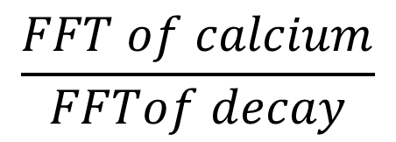

Time domain
Frequency domain
Calcium signal
FFT
FFT of calcium
$$noise+$$
Deconvolve
(hard)
Divide
(easy)
FFT
FFT of decay
FFT
$$\frac{FFT of calcium}{FFTof decay}$$
Spike train (desired result)
Notes:
Not optimal

Slide 6
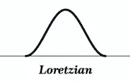
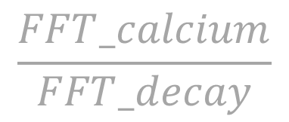
A problem …
Frequency domain
FFT_calcium
Divide
Might end up dividing by 0, or nearly 0
$$\frac{FFT_calcium}{FFT_decay}$$
Notes:
Not optimal

Slide 7
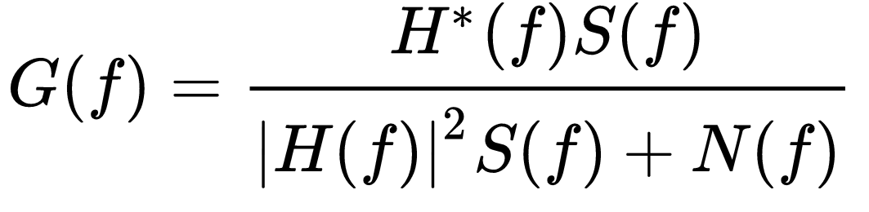
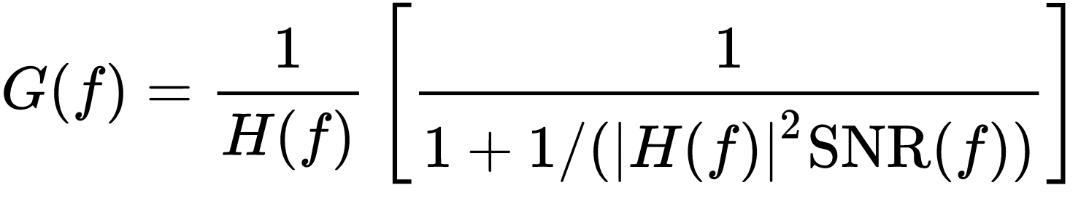
Weiner deconvolution
Notes:
Not optimal

Slide 8
Time domain
Impulse functions, one per action potential
(would like to recover this)
x[t]
w[t]
Extracellular spike shape
Convolve,
then add noise
(what you actually see)
y[t]
Notes:
Not optimal

Slide 9
Time domain
(not observable)
x[t]
Deconvolve
w[t]
(observable)
y[t]
Notes:
Not optimal

Slide 10
Time domain
Frequency domain
(not observable)
(not observable)
x[t]
FFT
X[f]
Deconvolve
Divide
FFT
w[t]
W[f]
(observable)
(observable)
FFT
y[t]
X[f]W[f] + N[f]
Notes:
Not optimal

Slide 11
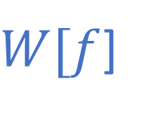

First attempted solution:
X[f]
$$\frac{1}{W[f]}$$
Divide
W[f]
$W[f$]
(observable)
X[f]W[f] + N[f]
Notes:
Not optimal

Slide 12
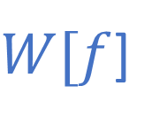

Major problems:
$$\frac{1}{W[f]}$$
$W[f$]
When W(f) is small, get large noise amplification
When W(f) = 0, get divide-by-zero error.
Notes:
Not optimal

Slide 13
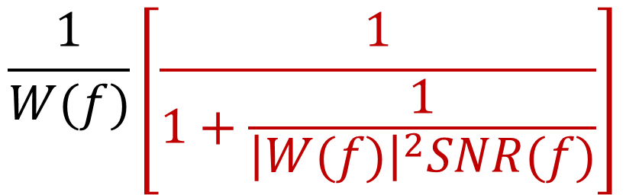
Weiner deconvolution
$$\frac{1}{W(f)}\left[\frac{1}{1+\frac{1}{{\left|W(f)\right|}^{2}SNR(f)}}\right]$$
Like dividing, but with this weird fudge factor …
SNR(f) = squared signal to noise ratio = E|X(f)|²/E|N(f)|²,
May not be known exactly, but can usually be estimated.
Notes:
Not optimal

Slide 14
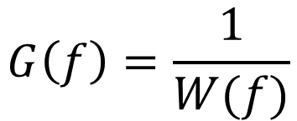
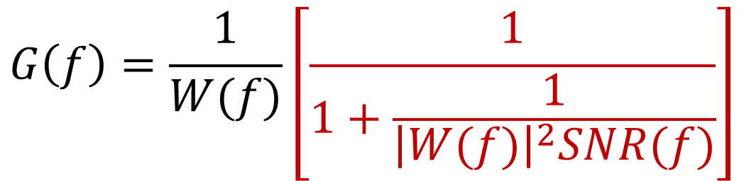
Evaluate when SNR = 0 or infinity
$$G\left(f\right)=\frac{1}{W(f)}\left[\frac{1}{1+\frac{1}{{\left|W(f)\right|}^{2}SNR(f)}}\right]$$
If noise = 0, then SNR =infinity, and fudge factor = 1:
$$G\left(f\right)=\frac{1}{W(f)}$$
If either W(f) = 0, or SNR(f) =0, then fudge = 0.
Notes:
Not optimal

Slide 15
Example from lecture 2:
Notes:
Not optimal

Slide 16
Calculate response G(f)
At first glance, seems to just be a crappy high-pass filter
Notes:
Not optimal

Slide 17
Deconvolution beats simple high-pass by almost 1 S.D.
Spikes
High-pass
Weiner
noise
Notes:
Not optimal

Slide 18

Weiner deconvolution beats any other filter.
Minimizes mean square error:
Expected square of difference between true signal and estimated signal.
Unobserved “true” signal
$$E{\left|x\left(t\right)−y(t)\right|}^{2}$$
Recovered “filtered” signal

Slide 19
Receiver operator characteristic (ROC) is closer to ideal
Weiner
High-pass
Perfect
detection
No filter
Notes:
Not optimal

Slide 20
Weiner has no time delay, also detects more spikes
Notes:
Not optimal

Slide 21
The End
Ignore all slides after this

Slide 22
Another application
In previous example, we used Matlab to design impulse response based on desired frequency response.
What if we have the opposite – we know the impulse response, but want to figure out the frequency reponse?

Slide 23
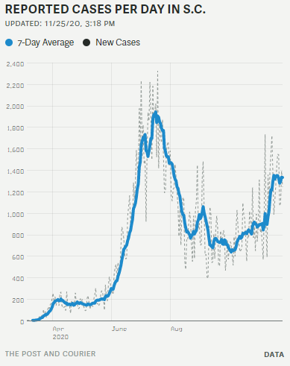
Example: a very common filter, 7-day moving average
Notes:
Not optimal

Slide 24
Moving average is convolution with “boxcar” function
Impulse response
Each value is 1/7 = 0.142857…
Notes:
Not optimal

Slide 25
Take FFT of “boxcar”…
Impulse response
Frequency response
= FFT of above pattern
Mostly low-pass.
“Ripples” at higher frequencies
Periodic “nulls” at frequencies 1/7, 2/7, 3/7, etc.
Frequency
Notes:
Not optimal

Slide 26
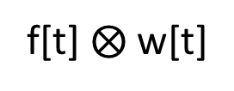
Moving average:
Time domain
Frequency domain
FFT
“f” = input waveform
FFT
“w” = Impulse function
Convolve
Multiply
FFT
f[t] $⨂$ w[t]
Notes:
Not optimal

Slide 27

Alternatives to boxcar.
Hamming window: $w\left(n\right)=0.54 −0.46 \cos{(\frac{2πn}{N−1})}$
Passband is about 2x wider than boxcar. But once the response comes down, it stays down.
Wider passband.
Smaller sidelobes

Slide 28
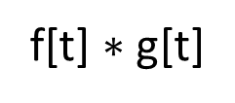
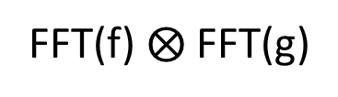
Can reverse where we do multiplication/convolution
Time domain
Frequency domain
FFT
f[t] = f₀, f₁, f₂, …
FFT(f)
g[t]=g₀, g₁, g₂, …
FFT(g)
Multiply
Convolve
f[t] $∗$ g[t]
FFT(f) $⨂$FFT(g)
FFT
Notes:
If you want to convolve A with the sum of B and C, you can break it into two easier tasks. First convolve A with B, then A with C, then add the two results.
All linear functions are handy this way, they can always be broken down into parts, solved independently, then added back together.

Slide 29
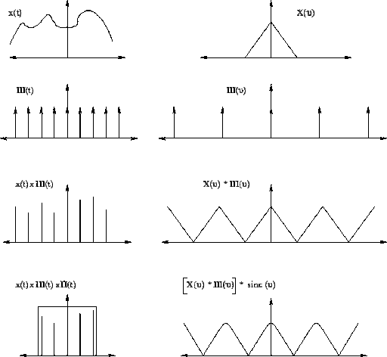
Sampling a continuous waveform = multiplication in time domain
Time domain
Frequency domain
-F/2
F/2
Impulse interval = 1/F
Impulse interval = F
Multiply
Convolve

Slide 30
Homework, due in two weeks (Dec 7, 2020)
Download the following two files to your MATLAB folder.
File #1 is a waveform plus “noise” around 2kHz.
https://www.dropbox.com/s/nvdwd3oeeifcqdb/Homework2.mat?dl=0
https://www.dropbox.com/s/ptwymcr8ynp5hir/Homework2.m?dl=0
File #2 is MATLAB code that loads file #1 and plays audio via speaker.
Task 1: write MATLAB code to remove the noise and identify the underlying musical piece. There should be at least two entirely different ways of removing the noise: one works in time domain, other in frequency domain
Task 2: Plot Fourier transforms of wave before and after filtering.

Slide 31
Good overview of filtering:
https://www.sciencedirect.com/science/article/pii/S0896627319301746

